Slide 1


Natural Language Processing
Ikernels Question Answering pipeline
Alessandro Moschitti, Kateryna Tymoshenko, Antonio Uva
Email: moschitti@disi.unitn.it, k.tymoshenko@gmail.com,
auva87@gmail.com
DISI, University of Trento
iKernels Lab

Slide 2
Outline
High-level QA domain overview
Ikernels Advanced Answer Passage reranking pipeline
(Lab) RelTextRank in action

Slide 3
Outline
High-level QA domain overview
Ikernels Advanced Answer Passage reranking pipeline
(Lab) RelTextRank in action

Slide 4
Question Answering Task
Overall objective: answering questions in natural language

Slide 5
Question Answering Task
Overall objective: answering questions in natural language
A very broad domain of research:
Closed-domain vs Open-Domain
questions about a specific domain, e.g. medicine/automobile parts
no restrictions, world knowledge (Q: What sports stadium has been billed as “the eighth wonder of the world”? A: Astrodome
Factoid vs subjective
“Who is the prime minister of Italy?” vs “Where should we go for dinner in Trento?”

Slide 6
Question Answering Task
Overall objective: answering questions in natural language
A very broad domain of research:
Closed-domain vs Open-Domain
questions about a specific domain, e.g. medicine/automobile parts
no restrictions, world knowledge (Q: What sports stadium has been billed as “the eighth wonder of the world”? A: Astrodome
Factoid vs subjective
“Who is the prime minister of Italy?” vs “Where should we go for dinner in Trento?”
The first automated approaches to QA originated in 1970s

Slide 7
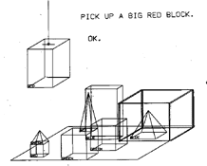
First QA systems
1971: LUNAR, analysis of moon rocks by Apollo
1968-1970: SHRDLU, T. Winograd, MIT
robot operating in a toy “blocks” (e.g cubes) world could answer the question about its state
~50 words to describe objects/locations
rule-based system
Person: WHAT DOES THE BOX CONTAIN?
Computer: THE BLUE PYRAMID AND THE BLUE BLOCK.
Person: WHAT IS THE PYRAMID SUPPORTED BY?
Computer: THE BOX.
Figure and example taken from: http://hci.stanford.edu/~winograd/shrdlu/

Slide 8
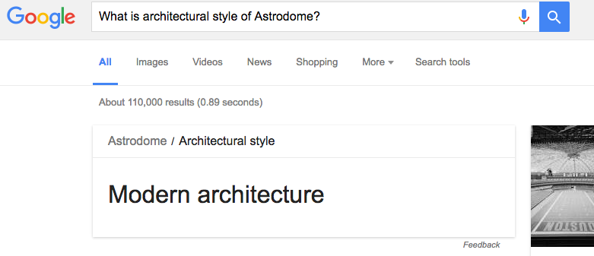
Modern QA systems
Personal assistants: Siri (Apple), Cortana (Microsoft)
Google search
2011 Jeopardy challenge by IBM
Watson beat humans at answering complex questions
Category: General Science
Clue: When hit by electrons, a phosphor gives off electromagnetic energy in this form.
Answer: Light (or Photons)

Slide 9
Partial list of QA research directions
Information-retrieval (IR) based
QA on knowledge bases
Community Question Answering (cQA)
Machine comprehension

Slide 10
Partial list of QA research directions
Information-retrieval (IR) based
QA on knowledge bases
Community Question Answering (cQA)
Machine comprehension

Slide 11
IR-based QA
What sports stadium has been billed as “the eighth wonder of the world"?
Web/Corpora
Search
Engine

Slide 12
IR-based QA
What sports stadium has been billed as “the eighth wonder of the world"?
Web/Corpora
Search
Engine
1.
It once was the Taj Mahal of sports. When the stadium opened in 1965 it was billed as the Eighth Wonder of the World.
x
The man behind the project, Judge Roy Hofheinz, modestly suggested the stadium be dubbed the Eighth Wonder of the World.
x
2.
The Titans ... played in the dilapidated Astrodome; if this was the eighth wonder of the world, we live on a shabby little planet indeed.
…
✔
16.

Slide 13
IR-based QA
What sports stadium has been billed as “the eighth wonder of the world"?
Web/Corpora
Search
Engine
16.
The Titans ... played in the dilapidated Astrodome; if this was the eighth wonder of the world, we live on a shabby little planet indeed.
…
✔
2.
The man behind the project, Judge Roy Hofheinz, modestly suggested the stadium be dubbed the Eighth Wonder of the World.
x
1.
It once was the Taj Mahal of sports. When the stadium opened in 1965 it was billed as the Eighth Wonder of the World.
x
Task of reranking answer passages/sentences is also called Answer Sentence Selection

Slide 14
Partial list of QA research directions
Information-retrieval (IR) based
QA on knowledge bases
Community Question Answering (cQA)
Machine comprehension

Slide 15


QA on Knowledge Bases (KB)
What sports stadium has been billed as “the eighth wonder of the world"?
Large-scale KBs
Freebase
(not active anymore)
dbpedia:Astrodome

Slide 16
QA on Knowledge Bases (KB)
What sports stadium has been billed as “the eighth wonder of the world"?
Convert the question to a query…
SELECT ?s WHERE
{
?s rdf:type owl:Stadium .
?s foaf:nick “Eighth Wonder of the World”@en }
Large-scale KBs
(See QALD challenge http://qald.sebastianwalter.org/)
Freebase
(not active anymore)
dbpedia:Astrodome

Slide 17
QA on Knowledge Bases (KB)
What sports stadium has been billed as “the eighth wonder of the world"?
Convert the question to a query…
… or use a deep Learning approach
for example, (Bordes et al. 2014)
SELECT ?s WHERE
{
?s rdf:type owl:Stadium .
?s foaf:nick “Eighth Wonder of the World”@en }
Large-scale KBs
(See QALD challenge http://qald.sebastianwalter.org/)
Freebase
(not active anymore)
dbpedia:Astrodome

Slide 18
Partial list of QA research directions
Information-retrieval (IR) based
QA on knowledge bases
Community Question Answering (cQA)
Machine comprehension

Slide 19
Community Question Answering (cQA)
Searching of answers on Community Question Answering resources: Stackoverflow, Quora, Yahoo Questions
Subtasks
Question-question similarity
User asks a new question, find an already answered question with the similar intent
Question comment reranking
Rerank comments to a question, so that the comments actually answering the question are on the top

Slide 20
Community Question Answering (cQA)
Searching of answers on Community Question Answering resources: Stackoverflow, Quora, Yahoo Questions
Subtasks
Question-question similarity
User asks a new question, find an already answered question with the similar intent
Question comment reranking
Rerank comments to a question, so that the comments actually answering the question are on the top
Challenges
Ongoing Quora Question Pairs challenge (https://www.kaggle.com/c/quora-question-pairs)
SemEval 2016 Qatar Living cQA challenge, Task 3 (http://alt.qcri.org/semeval2016/task3/)

Slide 21
SemEval 2016 Qatar Living cQa challenge
http://alt.qcri.org/semeval2016/task3/
Task A. Question-Comment similarity
Subj: Psychiatrist in DOHA
by princess_naila
Could someone advise the best psychiatrist/psycologist in DOHA?
Comments:
feba mariyam: i heard a good doctor in doha clinic... (potentially useful)
princess _naila: ok..shall check that out..thank you :) (Bad)
Equin0x: ”Visit Psychiatrist clinic of Hamad Hospital located opposite ””The Center”” exactly facing KFC.” (Good)

Slide 22
SemEval 2016 Qatar Living cQa challenge
http://alt.qcri.org/semeval2016/task3/
Task A. Question-Comment similarity
Subj: Psychiatrist in DOHA
by princess_naila
Could someone advise the best psychiatrist/psycologist in DOHA?
Comments:
feba mariyam: i heard a good doctor in doha clinic... (potentially useful)
princess _naila: ok..shall check that out..thank you :) (Bad)
Equin0x: ”Visit Psychiatrist clinic of Hamad Hospital located opposite ””The Center”” exactly facing KFC.” (Good)
Task B. Question-Question similarity
Subj: Where is Doha clinic?
Can anybody tell me where is Doha clinic?
Duplicate Candidates:
Help .. Good pediatrics at Doha clinic ? (Relevant)
Knee Surgery @ Doha Clinic (Relevant)
Can anyone recommend a good Chiropractor?? (Irrelevant)
Is there any private clinic in qatar or hospital that i can give birth which cost only 10;000 riyal? (Irrelevant)

Slide 23
SemEval 2016 Qatar Living cQa challenge
http://alt.qcri.org/semeval2016/task3/
Task A. Question-Comment similarity
Subj: Psychiatrist in DOHA
by princess_naila
Could someone advise the best psychiatrist/psycologist in DOHA?
Comments:
feba mariyam: i heard a good doctor in doha clinic... (potentially useful)
princess _naila: ok..shall check that out..thank you :) (Bad)
Equin0x: ”Visit Psychiatrist clinic of Hamad Hospital located opposite ””The Center”” exactly facing KFC.” (Good)
Task B. Question-Question similarity
Subj: Where is Doha clinic?
Can anybody tell me where is Doha clinic?
Duplicate Candidates:
Help .. Good pediatrics at Doha clinic ? (Relevant)
Knee Surgery @ Doha Clinic (Relevant)
Can anyone recommend a good Chiropractor?? (Irrelevant)
Is there any private clinic in qatar or hospital that i can give birth which cost only 10;000 riyal? (Irrelevant)
Find more tasks and corpora at http://alt.qcri.org/semeval2016/task3/

Slide 24
Partial list of QA research directions
Information-retrieval (IR) based
QA on knowledge bases
Community Question Answering (cQA)
Machine comprehension

Slide 25
Machine comprehension: answering questions about a text
In meteorology, precipitation is any product of the condensation of atmospheric water vapor that falls under gravity. The main forms of precipitation include drizzle, rain, sleet, snow, graupel and hail...
Precipitation forms as smaller droplets coalesce via collision with other rain drops or ice crystals within a cloud. Short, intense periods of rain in scattered locations are called “showers”.
What causes precipitation to fall?
Gravity
What is another main form of precipitation besides drizzle, rain, snow, sleet and hail?
Graupel
Where do water droplets collide with ice crystals to form precipitation?
within a cloud
Example taken from (Rajpurkar et al., 2016)

Slide 26
Machine comprehension: answering questions about a text
In meteorology, precipitation is any product of the condensation of atmospheric water vapor that falls under gravity. The main forms of precipitation include drizzle, rain, sleet, snow, graupel and hail...
Precipitation forms as smaller droplets coalesce via collision with other rain drops or ice crystals within a cloud. Short, intense periods of rain in scattered locations are called “showers”.
What causes precipitation to fall?
Gravity
What is another main form of precipitation besides drizzle, rain, snow, sleet and hail?
Graupel
Where do water droplets collide with ice crystals to form precipitation?
within a cloud
Example taken from (Rajpurkar et al., 2016)
Some Relevant corpora:
SQUAD (Rajpurkar et al., 2016), https://rajpurkar.github.io/SQuAD-explorer/
Crowdsourced, based on Wikipedia
Ms Marco(Rajpurkar et al., 2016), http://www.msmarco.org/
User query logs as questions, Relevant web-pages as a source of answers

Slide 27
Types of question answering
Information-retrieval (IR) based factoid question answering
QA on knowledge bases
Community Question Answering (cQA)
Machine comprehension

Slide 28
Ikernels Advance pipeline applied to…
Information-retrieval based factoid question answering
QA on knowledge bases
Community Question Answering (cQA)
Question-comment similarity
Machine comprehension

Slide 29
Outline
High-level QA domain overview
Ikernels Advanced Answer Passage reranking pipeline
(Lab) RelTextRank in action

Slide 30
Ikernels Advanced Pipeline
Text pair classification/reranking pipeline
Text pairs can be, for example, questions and candidate answer passages

Slide 31
Ikernels Advanced Pipeline
Text pair classification/reranking pipeline
Text pairs can be, for example, questions and candidate answer passages
Employs convolutional tree kernels and feature vectors
You can use embeddings learned by the neural networks as feature vectors

Slide 32
Ikernels Advanced Pipeline
Text pair classification/reranking pipeline
Text pairs can be, for example, questions and candidate answer passages
Employs convolutional tree kernels and feature vectors
You can use embeddings learned by the neural networks as feature vectors
Represents text pairs as relational structures

Slide 33
Ikernels Advanced Pipeline
Text pair classification/reranking pipeline
Employs convolutional tree kernels and feature vectors
Represents text pairs as relational structures
Obtains state-of-the-art results on a number of corpora
State-of-the-art results on answer sentence selection WikiQA, Trec13, Trec QA
2 place in SemEval Task A community QA competition

Slide 34
Ikernels Advanced Pipeline
Text pair classification/reranking pipeline
Employs convolutional tree kernels and feature vectors
Represents text pairs as relational structures
Obtains state-of-the-art results on a number of corpora
State-of-the-art results on answer sentence selection WikiQA, Trec13, Trec QA
2 place in SemEval Task A community QA competition

Slide 35
Outline
IR-based QA and its components
Motivation behind the approach
Learning with kernels
Tree kernels recap
Structural representations and relational links for Answer Sentence Selection (IR-based QA)
Structural representations for Community Question Answering
Metrics and results

Slide 36
Outline
IR-based QA and its components
Motivation behind the approach
Learning with kernels
Tree kernels recap
Structural representations and relational links for Answer Sentence Selection (IR-based QA)
Structural representations for Community Question Answering
Metrics and results

Slide 37
IR-based QA
What sports stadium has been billed as “the eighth wonder of the world"?
Web/Corpora
Search
Engine
16.
The Titans ... played in the dilapidated Astrodome; if this was the eighth wonder of the world, we live on a shabby little planet indeed.
…
✔
2.
The man behind the project, Judge Roy Hofheinz, modestly suggested the stadium be dubbed the Eighth Wonder of the World.
x
1.
It once was the Taj Mahal of sports. When the stadium opened in 1965 it was billed as the Eighth Wonder of the World.
x

Slide 38
IR-based QA overall schema
Corpus/Web
Search Index
Question
Processing
Passage retrieval
Answer processing
Document/Passage retrieval
Passages
Query Formulation
Passage
Reranking
Question
Answer Type
Detection
Answer extraction
Question
Focus
Detection
Additional Analyzers/Knowledge bases/Wikipedia
Answer
Figure based on the illustration in the draft of the 3rd edition “Speech and language processing
by D. Jurafsky and James H. Martin https://web.stanford.edu/~jurafsky/slp3/28.pdf

Slide 39
IR-based QA overall schema
Corpus/Web
Search Index
Question
Processing
Passage retrieval
Answer processing
Document/Passage retrieval
Passages
Query Formulation
Passage
Reranking
Question
Answer Type
Detection
Answer extraction
Question
Focus
Detection
Additional Analyzers/Knowledge bases/Wikipedia
Answer
Figure based on the illustration in the draft of the 3rd edition “Speech and language processing
by D. Jurafsky and James H. Martin https://web.stanford.edu/~jurafsky/slp3/28.pdf

Slide 40
Answer type detection
Expected answer type/Question Class
Definition, description, entity, human, location, manner, number organization…
What sports stadium has been billed as “the eighth wonder of the world"? -> LOCATION
We use a labeled QC corpus (Li&Roth, 2002)
HUM, ENTY, LOC, ABBR, DESC, NUM
32 fine-grained classes
http://cogcomp.cs.illinois.edu/Data/QA/QC/

Slide 41
Answer type detection
Expected answer type/Question Class
Definition, description, entity, human, location, manner, number organization…
What sports stadium has been billed as “the eighth wonder of the world"? -> LOCATION
We use a labeled QC corpus (Li&Roth, 2002)
HUM, ENTY, LOC, ABBR, DESC, NUM
32 fine-grained classes
http://cogcomp.cs.illinois.edu/Data/QA/QC/
The pipeline employs a tree kernel-based based approach for question classification (Croce at al., 2011)
Accuracy 85-95 %

Slide 42
IR-based QA overall schema
Corpus/Web
Search Index
Question
Processing
Passage retrieval
Answer processing
Document/Passage retrieval
Passages
Query Formulation
Passage
Reranking
Question
Answer Type
Detection
Answer extraction
Question
Focus
Detection
Additional Analyzers/Knowledge bases/Wikipedia
Answer
Figure based on the illustration in the draft of the 3rd edition “Speech and language processing
by D. Jurafsky and James H. Martin https://web.stanford.edu/~jurafsky/slp3/28.pdf

Slide 43
Question focus detection
Question focus is a
“noun that is property or entity being sought by the question” (Prager, 2006)
“the set of all maximal noun phrases in the question that corefer with the answer” (Bunescu and Huang, 2010)
Example: What sports stadium has been billed as “the eighth wonder of the world"?

Slide 44
Question focus detection
Question focus is a
“noun that is property or entity being sought by the question” (Prager, 2006)
“the set of all maximal noun phrases in the question that corefer with the answer” (Bunescu and Huang, 2010)
Example: What sports stadium has been billed as “the eighth wonder of the world"?

Slide 45
Question focus detection
Question focus is a
“noun that is property or entity being sought by the question” (Prager, 2006)
“the set of all maximal noun phrases in the question that corefer with the answer” (Bunescu and Huang, 2010)
Example: What sports stadium has been billed as “the eighth wonder of the world"?
Corpora available
SeCo-600 (Quarteroni et al., 2012), Mooney GeoQuery (Damljanovic et al., 2010), (Bunescu and Huang, 2010)
80-98% accuracy with Tree Kernel-based approaches

Slide 46
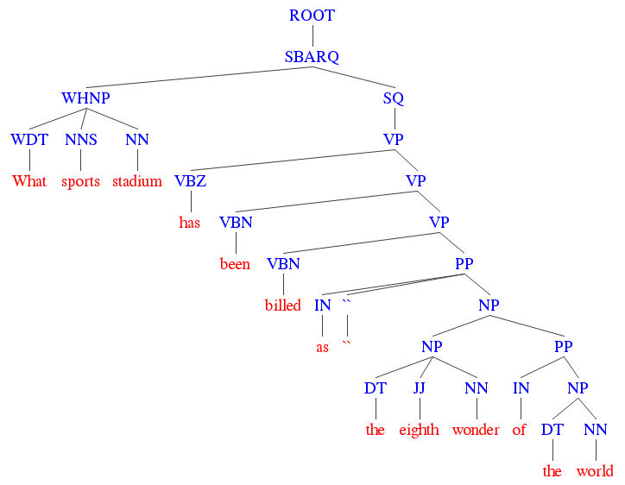
Focus detection with TK

Slide 47
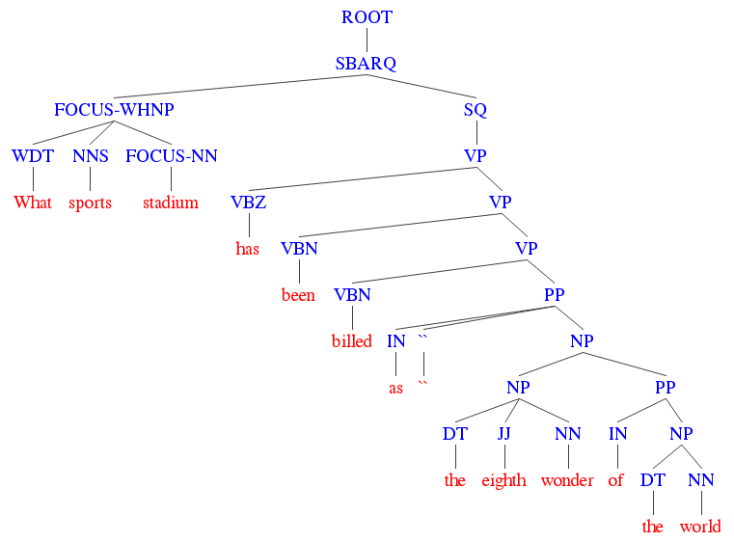
Focus detection with TK
+1: positive example

Slide 48
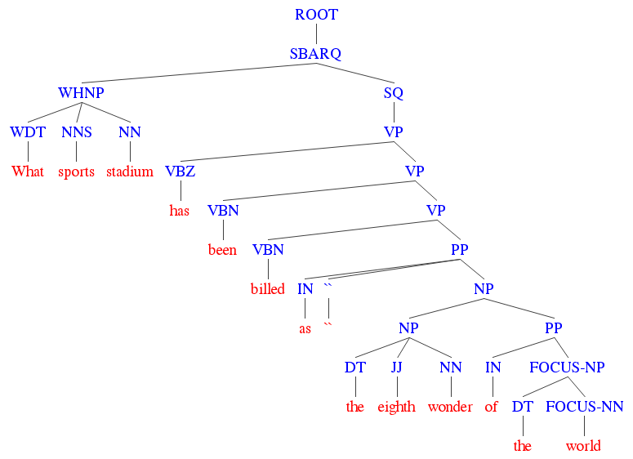
Focus detection with TK
-1: negative example

Slide 49
IR-based QA overall schema
Corpus/Web
Search Index
Question
Processing
Passage retrieval
Answer processing
Document/Passage retrieval
Passages
Query Formulation
Passage
Reranking
Question
Answer Type
Detection
Answer extraction
Question
Focus
Detection
Additional Analyzers/Knowledge bases/Wikipedia
Answer
Figure based on the illustration in the draft of the 3rd edition “Speech and language processing
by D. Jurafsky and James H. Martin https://web.stanford.edu/~jurafsky/slp3/28.pdf

Slide 50
IR-based QA overall schema
Corpus/Web
Search Index
Question
Processing
Passage retrieval
Answer processing
Document/Passage retrieval
Passages
Query Formulation
PASSAGE
RERANKING
Question
Answer Type
Detection
Answer extraction
Question
Focus
Detection
Additional Analyzers/Knowledge bases/Wikipedia
Answer
Figure based on the illustration in the draft of the 3rd edition “Speech and language processing
by D. Jurafsky and James H. Martin https://web.stanford.edu/~jurafsky/slp3/28.pdf

Slide 51
Outline
IR-based QA and its components
Motivation behind the approach
Learning with kernels
Tree kernels recap
Structural representations and relational links for Answer Sentence Selection (IR-based QA)
Structural representations for Community Question Answering
Metrics and results

Slide 52
Candidate answer passage reranking
What sports stadium has been billed as “the eighth wonder of the world"?
Fast Recall
Search
Engine
Corpus
1.
It once was the Taj Mahal of sports. When the stadium opened in 1965 it was billed as the Eighth Wonder of the World.
x
2.
The man behind the project, Judge Roy Hofheinz, modestly suggested the stadium be dubbed the Eighth Wonder of the World.
x
…
The Titans ... played in the dilapidated Astrodome; if this was the eighth wonder of the world, we live on a shabby little planet indeed.
16.
✔

Slide 53
Candidate answer passage reranking
What sports stadium has been billed as “the eighth wonder of the world"?
Fast Recall
Search
Engine
Corpus
1.
It once was the Taj Mahal of sports. When the stadium opened in 1965 it was billed as the Eighth Wonder of the World.
The Titans ... played in the dilapidated Astrodome; if this was the eighth wonder of the world, we live on a shabby little planet indeed.
x
16.
✔
The man behind the project, Judge Roy Hofheinz, modestly suggested the stadium be dubbed the Eighth Wonder of the World.
…
2.
1.
It once was the Taj Mahal of sports. When the stadium opened in 1965 it was billed as the Eighth Wonder of the World.
x
x
…
The Titans ... played in the dilapidated Astrodome; if this was the eighth wonder of the world, we live on a shabby little planet indeed.
The man behind the project, Judge Roy Hofheinz, modestly suggested the stadium be dubbed the Eighth Wonder of the World.
16.
2.
✔
x

Slide 54
Candidate answer passage reranking
What sports stadium has been billed as “the eighth wonder of the world"?
Fast Recall
Search
Engine
Corpus
The Titans ... played in the dilapidated Astrodome; if this was the eighth wonder of the world, we live on a shabby little planet indeed.
Useful clues:
Lexical overlap between Q/A
Specific syntactic/semantic patterns
When was <X> born? -> <X>, born on <Y>,..
Answer type/Question focus match with named entities in the Candidate Answer
16.
✔
…
1.
It once was the Taj Mahal of sports. When the stadium opened in 1965 it was billed as the Eighth Wonder of the World.
x
2.
The man behind the project, Judge Roy Hofheinz, modestly suggested the stadium be dubbed the Eighth Wonder of the World.
x

Slide 55
Candidate answer passage reranking
What sports stadium has been billed as “the eighth wonder of the world"?
Fast Recall
Search
Engine
Corpus
The Titans ... played in the dilapidated Astrodome; if this was the eighth wonder of the world, we live on a shabby little planet indeed.
The solution requires
a combination of
Syntax and Semantics
16.
✔
…
1.
It once was the Taj Mahal of sports. When the stadium opened in 1965 it was billed as the Eighth Wonder of the World.
x
2.
The man behind the project, Judge Roy Hofheinz, modestly suggested the stadium be dubbed the Eighth Wonder of the World.
x

Slide 56
Candidate answer passage reranking
What sports stadium has been billed as “the eighth wonder of the world"?
Fast Recall
Search
Engine
Corpus
The Titans ... played in the dilapidated Astrodome; if this was the eighth wonder of the world, we live on a shabby little planet indeed.
Possible solution
16.
✔
Shallow and deep syntactic trees
…
1.
It once was the Taj Mahal of sports. When the stadium opened in 1965 it was billed as the Eighth Wonder of the World.
+
x
Question classifiers, NER, Linked Data, Wikipedia
2.
The man behind the project, Judge Roy Hofheinz, modestly suggested the stadium be dubbed the Eighth Wonder of the World.
x
56
56

Slide 57
Outline
IR-based QA and its components
Motivation behind the approach
Learning with kernels
Tree kernels recap
Structural representations and relational links for Answer Sentence Selection (IR-based QA)
Structural representations for Community Question Answering
Metrics and results

Slide 58
Feature vector representation
Similarity feature vector x:
Lexical: n-grams,
Syntactic: dependency path, TED, ..
Semantic: WN, ESA, LSA, LDA,
Expected answer type match
Embeddings learned by the neural networks
Question
Corpus
Search
Engine
Answer Passage 1
x(q,p₁) = (x₁¹, ... , x_{N}¹ )
Answer Passage 2
x(q,p₂) = (x₁², ... , x_{N}² )
…
…
Answer Passage i
x(q,p_{i}) = (x₁^{i}, ... , x_{N}^{i} )
…
…
Answer Passage M
x(q,p_{M}) = (x₁^{M}, … , x_{N}^{M})
question
answer passage

Slide 59
Feature vector representation
Laborious features/rules engineering: lot of effort, intuition;
difficulty to capture structural patterns;
Need of large corpora
Question
Weight vector,
learnt from training
data
Corpus
Search
Engine
Answer Passage 1
w∙x(q,p₁) = .8
Answer Passage 2
w∙x(q,p₂) = .2
…
…
Answer Passage i
w∙x(q,p_{i}) = .1
…
…
Answer Passage M
w∙x(q,p_{N}) = .4

Slide 60
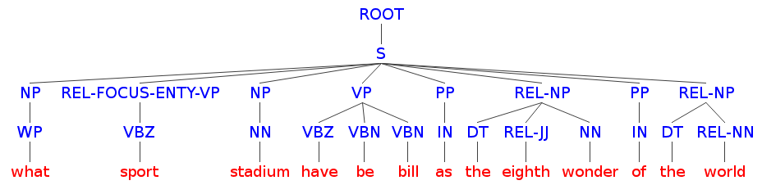
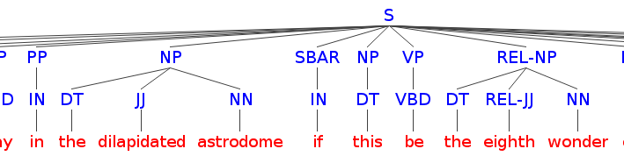
Implicit Feature Representation
Q
What sports stadium has been billed as “the eighth wonder of the world"?
(
,
;
)
(x₁, x₂, …, x_{N})
Model Q/P pairs as structures
Tree Kernels (TK) and SVM to learn patterns
Similarity vector
A
The Titans played in the dilapidated Astrodome; if this was the eighth wonder of the world, we live on a shabby little planet indeed.

Slide 61
Learning with Kernels: an example
Question 1
Answer 1
Feature Vector 1
(
,
;
)
(x₁, x₂, …, x_{N})
(
,
;
)
(x₁, x₂, …, x_{N})
Question 2
Answer 2
Feature Vector 2

Slide 62
Learning with Kernels: an example
Question 1
Answer 1
Feature Vector 1
(
,
;
)
(x₁, x₂, …, x_{N})
K_{TK}
K_{TK}
K_{feat}
+
+
(
,
;
)
(x₁, x₂, …, x_{N})
Question 2
Answer 2
Feature Vector 2

Slide 63
Learning with Kernels: an example
Question 1
Answer 1
Feature Vector 1
(
,
;
)
(x₁, x₂, …, x_{N})
Kernel applied to feature vectors,
e.g., scalar product or polynomial kernel
K_{TK}
K_{TK}
K_{feat}
+
+
(
,
;
)
(x₁, x₂, …, x_{N})
Question 2
Answer 2
Feature Vector 2

Slide 64
Learning with Kernels: an example
Q
What sports stadium has been billed as “the eighth wonder of the world"?
(
,
;
)
(x₁, x₂, …, x_{N})
Tree Kernels:
similarity in terms of number of common substructures shared by two trees
K_{TK}
K_{TK}
K_{feat}
+
+
(
,
;
)
(x₁, x₂, …, x_{N})
A
The Titans played in the dilapidated Astrodome; if this was the eighth wonder of the world, we live on a shabby little planet indeed.

Slide 65
Classification function of Kernel Machines
The equation of a hyperplane is
is the vector representing the classifying example
is the gradient of the hyperplane (learned model)
The classification function is
Note that the hyperplane classifier is just:

Slide 66
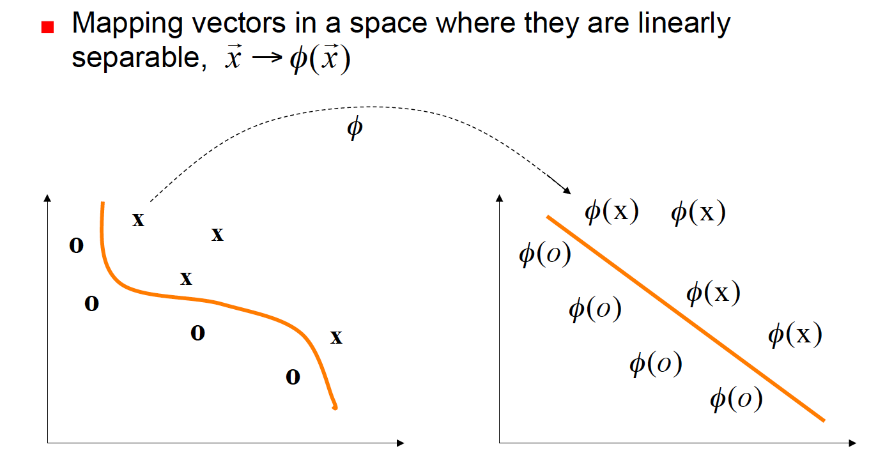
The main idea of the kernel functions

Slide 67
The Kernel Trick
Kernel Machines (e.g., SVMs or perceptron) are such that
Hence the classification function results:
Note that data only appears in the scalar product
We can use the function k in place of the scalar product

Slide 68
The Kernel Trick
Kernel Machines (e.g., SVMs or perceptron) are such that
Hence the classification function results:
Note that data only appears in the scalar product
We can use the function k in place of the scalar product

Slide 69
Tree Kernel Similarity
VP
VP
V
NP
V
NP
hit
D
N
hit
D
N
a
phosphor
a
surface
69

Slide 70
Tree Kernel Similarity
VP
VP
V
NP
V
NP
hit
D
N
hit
D
N
a
phosphor
a
surface
70

Slide 71
Explicit kernel space
Notes:
14:45

Slide 72
Explicit kernel space
Notes:
14:45

Slide 73
Explicit kernel space
counts the number of common substructures
Notes:
14:45

Slide 74
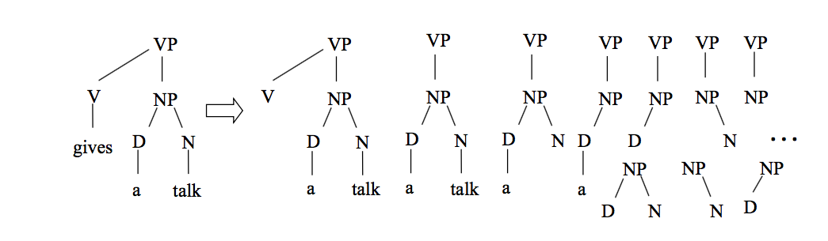
Structures by Syntactic Tree Kernel
(Moschitti, 2006)
Subtree: any node with its descendants
Grammatical rules cannot be broken

Slide 75
Structures by syntactic tree kernel
(Moschitti, 2006)
Subtree: any node with its descendants
Grammatical rules cannot be broken
[NP [D]] Not a valid STK structure

Slide 76
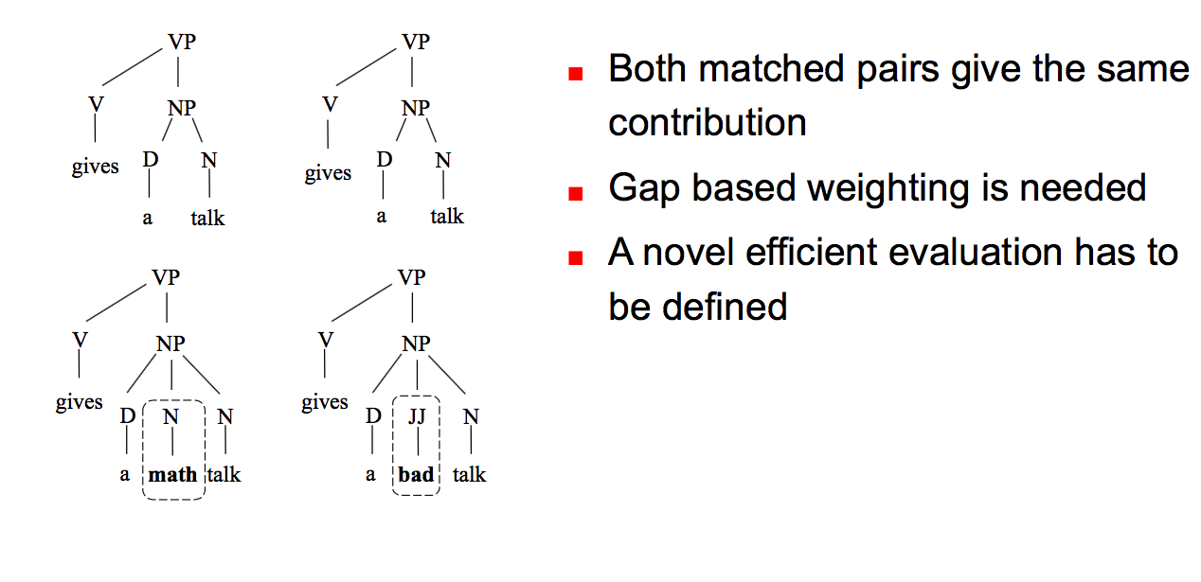
Partial tree kernel
(Moschitti, 2006)

Slide 77
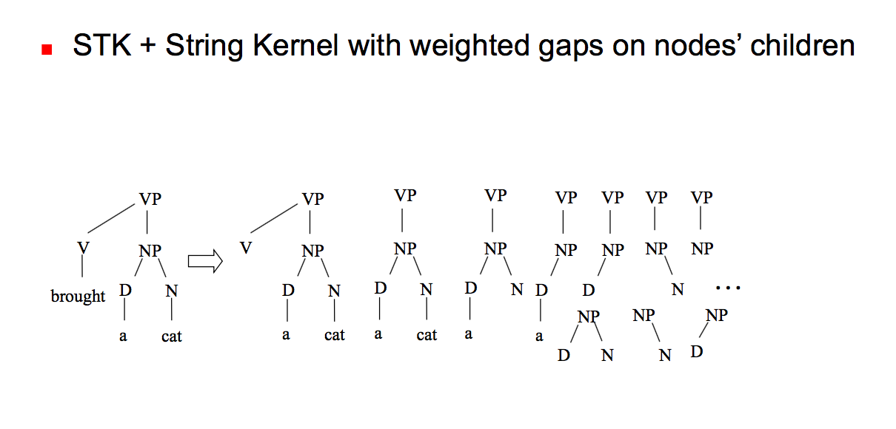
Partial tree kernel
(Moschitti, 2006)
[NP [D]] VALID PTK structure

Slide 78
Outline
IR-based QA and its components
Motivation behind the approach
Learning with kernels
Tree kernels recap
Structural representations and relational links for Answer Sentence Selection (IR-based QA)
Structural representations for Community Question Answering
Metrics and results

Slide 79
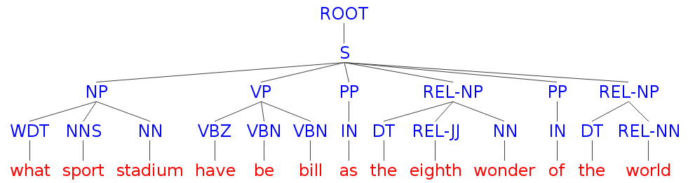
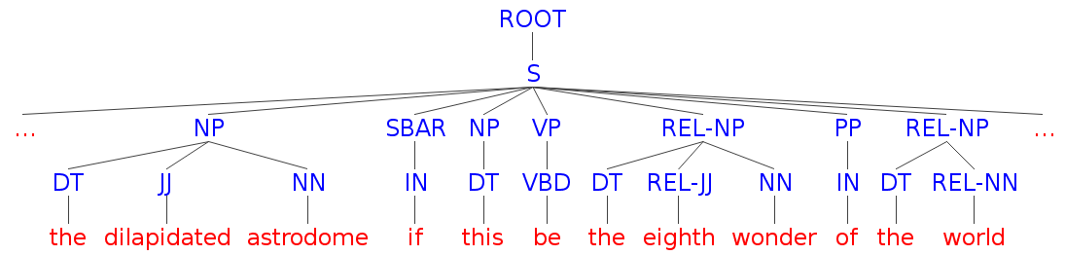
Chunk Representation (CH) (Severyn & Moschitti, SIGIR2012)
Q
What sports stadium has been billed as “the eighth wonder of the world"?
A
The Titans played in the dilapidated Astrodome; if this was the eighth wonder of the world, we live on a shabby little planet indeed.
Notes:
Shallow parsing, identification of POS

Slide 80
Chunk Representation (CH) (Severyn & Moschitti, SIGIR2012)
Q
What sports stadium has been billed as “the eighth wonder of the world"?
A
The Titans played in the dilapidated Astrodome; if this was the eighth wonder of the world, we live on a shabby little planet indeed.

Slide 81
Chunk Representation (CH) (Severyn & Moschitti, SIGIR2012)
Q
What sports stadium has been billed as “the eighth wonder of the world"?
Hard string match
LDA, WordNet-based similarity
did not improve
A
The Titans played in the dilapidated Astrodome; if this was the eighth wonder of the world, we live on a shabby little planet indeed.

Slide 82
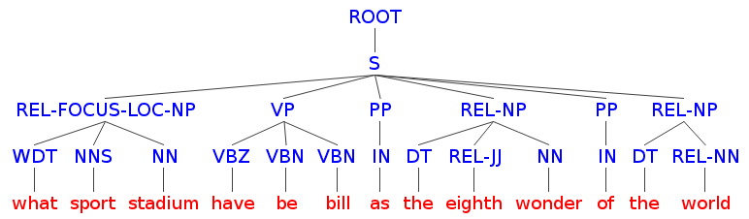

CH+FREL
(Severyn et al., 2013)
Q
What sports stadium has been billed as “the eighth wonder of the world"?
FOCUS and Question Class derived by classifiers
A
The Titans played in the dilapidated Astrodome; if this was the eighth wonder of the world, we live on a shabby little planet indeed.

Slide 83
CH+FREL
(Severyn et al., 2013)
Q
What sports stadium has been billed as “the eighth wonder of the world"?
NER: LOC
A
The Titans played in the dilapidated Astrodome; if this was the eighth wonder of the world, we live on a shabby little planet indeed.

Slide 84
CH+FREL
(Severyn et al., 2013)
Q
What sports stadium has been billed as “the eighth wonder of the world"?
A
The Titans played in the dilapidated Astrodome; if this was the eighth wonder of the world, we live on a shabby little planet indeed.

Slide 85
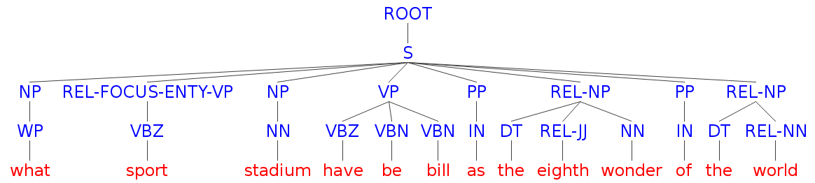
Type match intuition
(Tymoshenko et al., 2014)
Q
What sports stadium has been billed as “the eighth wonder of the world"?
A
The Titans played in the dilapidated Astrodome; if this was the eighth wonder of the world, we live on a shabby little planet indeed.
NER detectors and Question Classifiers make errors

Slide 86
Type match intuition
(Tymoshenko et al., 2014)
Q
What sports stadium has been billed as “the eighth wonder of the world"?
Wrong class
No Match
A
The Titans played in the dilapidated Astrodome; if this was the eighth wonder of the world, we live on a shabby little planet indeed.
NER detectors and Question Classifiers make errors

Slide 87
Type match intuition
(Tymoshenko et al., 2014)
Q
What sports stadium has been billed as “the eighth wonder of the world"?
class anchor
Type Match
(TM)
entity/class anchor
A
The Titans played in the dilapidated Astrodome; if this was the eighth wonder of the world, we live on a shabby little planet indeed.

Slide 88
Linked Open Data
Structured knowledge published according to LOD principles
organized as directed graph/statements
can be queried using SPARQL language
commonly shared knowledge schemes
rdfs:subClassOf, rdf:type, rdf:label

Slide 89
Linked Open Data
Structured knowledge published according to LOD principles
organized as directed graph/statements
can be queried using SPARQL language
commonly shared knowledge schemes
rdfs:subClassOf, rdf:type, rdf:label
http://dbpedia.org/resource/Astrodome
http://dbpedia.org/ontology/openingDate
1965-04-09
http://dbpedia.org/ontology/location
http://dbpedia.org/property/nickname
http://dbpedia.org/resource/Texas
“Eighth Wonder of the World (en)”

Slide 90
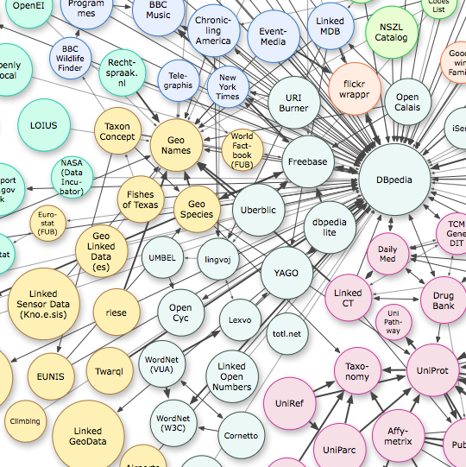
LOD datasets
Wikipedia converted to RDF
Aligned to Wikipedia on concept-level

Slide 91
LOD datasets
Freebase
Wikipedia + human contributors + MusicBranz + OurAirports +...
Wikipedia converted to RDF
Aligned to Wikipedia on concept-level

Slide 92
LOD datasets
Freebase
Wikipedia + human contributors + MusicBranz + OurAirports +...
YAGO
Wikipedia + Wordnet
Wikipedia converted to RDF
Aligned to Wikipedia on concept-level

Slide 93
LOD datasets
Freebase
Wikipedia + human contributors + MusicBranz + OurAirports +...
YAGO
Wikipedia + Wordnet
WordNet (W3C) (WordNet 2.0 [Van Assem et al.])
WordNet (VUA) (WordNet 3.0)
Large lexical database of English (synonymy/antonymy/hypernymy)
Wikipedia converted to RDF
Aligned to Wikipedia on concept-level

Slide 94
Type match intuition
Q
What sports stadium has been billed as “the eighth wonder of the world"?
Linked Open Data (LOD):
Yago, DBpedia, WordNet
class anchor
class
Type Match
(TM)
isa/subclassOf
entity/class
entity/class anchor
A
The Titans played in the dilapidated Astrodome; if this was the eighth wonder of the world, we live on a shabby little planet indeed.

Slide 95
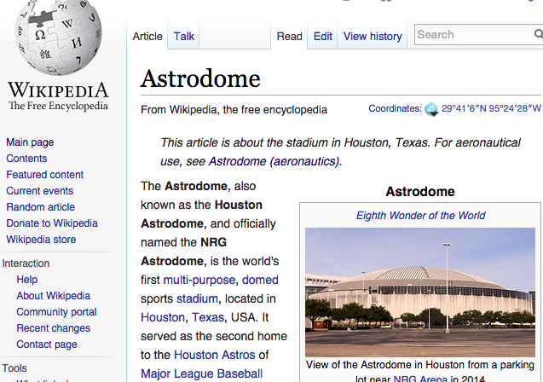
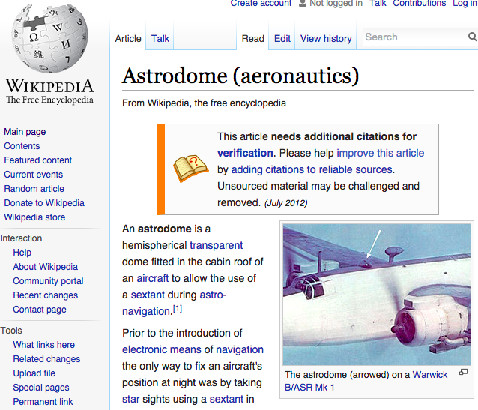
Type match intuition
Q
What sports stadium has been billed as “the eighth wonder of the world"?
A
The Titans played in the dilapidated Astrodome; if this was the eighth wonder of the world, we live on a shabby little planet indeed.

Slide 96
Matching algorithm
Q
What sports stadium has been billed as “the eighth wonder of the world"?
A
The Titans played in the dilapidated Astrodome; if this was the eighth wonder of the world, we live on a shabby little planet indeed.

Slide 97
Matching algorithm
Q
What sports stadium has been billed as “the eighth wonder of the world"?
yago:Reliant_
Astrodome
A
The Titans played in the dilapidated Astrodome; if this was the eighth wonder of the world, we live on a shabby little planet indeed.

Slide 98
Matching algorithm
Q
What sports stadium has been billed as “the eighth wonder of the world"?
yago:wordnet_stadium_104295881
yago:Reliant_
Astrodome
yago:wikicat_Covered_stadiums
YAGO
A
The Titans played in the dilapidated Astrodome; if this was the eighth wonder of the world, we live on a shabby little planet indeed.

Slide 99
Matching algorithm
Q
What sports stadium has been billed as “the eighth wonder of the world"?
yago:wordnet_stadium_104295881
"stadium"@eng
yago:Reliant_
Astrodome
yago:wikicat_Covered_stadiums
YAGO
A
The Titans played in the dilapidated Astrodome; if this was the eighth wonder of the world, we live on a shabby little planet indeed.

Slide 100
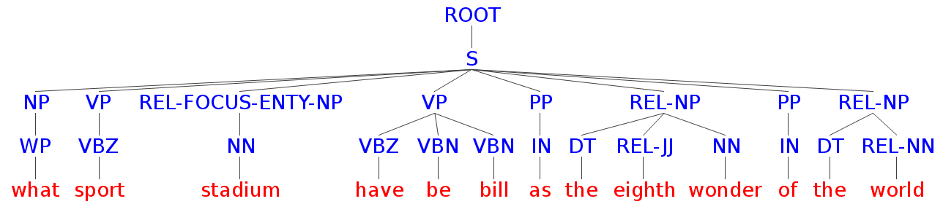
Encoding type match
Q
What sports stadium has been billed as “the eighth wonder of the world"?
A
The Titans played in the dilapidated Astrodome; if this was the eighth wonder of the world, we live on a shabby little planet indeed.

Slide 101
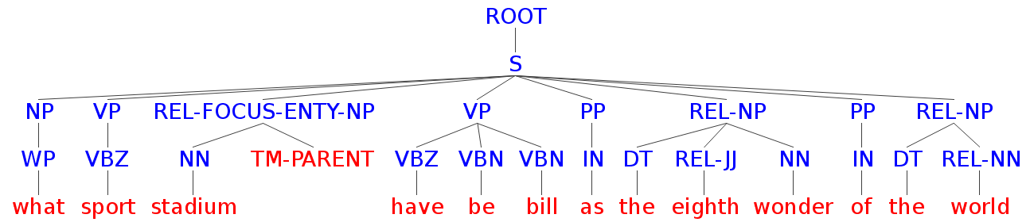
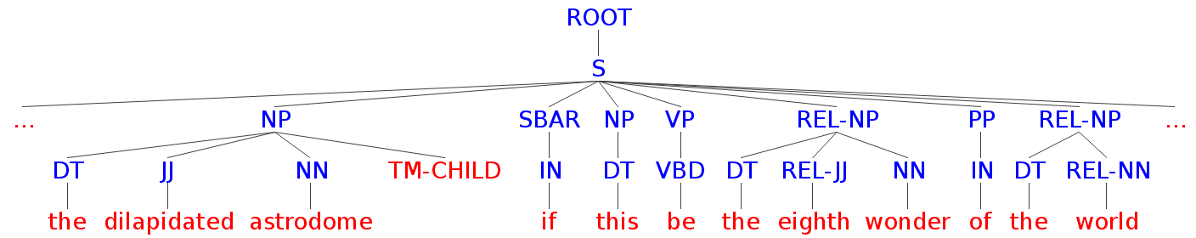
Encoding type match: TM
Q
What sports stadium has been billed as “the eighth wonder of the world"?
TM
TM
A
The Titans played in the dilapidated Astrodome; if this was the eighth wonder of the world, we live on a shabby little planet indeed.

Slide 102
Encoding type match: TMND
Q
What sports stadium has been billed as “the eighth wonder of the world"?
TM-PARENT
TM-CHILD
A
The Titans played in the dilapidated Astrodome; if this was the eighth wonder of the world, we live on a shabby little planet indeed.

Slide 103
Encoding type match: TMNF
Q
What sports stadium has been billed as “the eighth wonder of the world"?
TM-FOCUS
TM-FOCUS
A
The Titans played in the dilapidated Astrodome; if this was the eighth wonder of the world, we live on a shabby little planet indeed.

Slide 104
Dependency representations
What sports stadium has been billed as “the eighth wonder of the world"?
root(ROOT, billed)
det(wonder,the)
punct(wonder,“)
nmod(billed,wonder)
case(wonder,as)
aux(billed,has)
compound(stadium,sports)
det(stadium,What)
case(world,of)
nsubjpass(billed,stadium)
auxpass(billed,been)
nmod(wonder,world)
amod(wonder,eighth)
det(world,the)
punct(billed,?)

Slide 105
Dependency representations
What sports stadium has been billed as “the eighth wonder of the world"?
root(ROOT, billed)
det(wonder,the)
punct(wonder,“)
nmod(billed,wonder)
case(wonder,as)
aux(billed,has)
compound(stadium,sports)
det(stadium,What)
case(world,of)
nsubjpass(billed,stadium)
auxpass(billed,been)
nmod(wonder,world)
amod(wonder,eighth)
det(world,the)
punct(billed,?)
We use dependency information to
build several kinds of tree representations

Slide 106
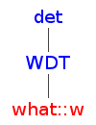
Dependency Tree 1 (DT1)
(Severyn et al., 2013)
Q
What sports stadium has been billed as “the eighth wonder of the world"?
det(stadium, What)

Slide 107
Dependency Tree 1 (DT1)
(Severyn et al., 2013)
Q
What sports stadium has been billed as “the eighth wonder of the world"?
det(stadium, What)
nsubjpass(billed,stadium)

Slide 108
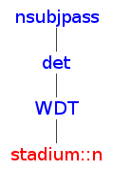
Dependency Tree 1 (DT1)
(Severyn et al., 2013)
Q
What sports stadium has been billed as “the eighth wonder of the world"?
det(stadium, What)
nsubjpass(billed,stadium)

Slide 109
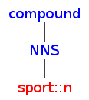
Dependency Tree 1 (DT1)
(Severyn et al., 2013)
Q
What sports stadium has been billed as “the eighth wonder of the world"?
det(stadium, What)
nsubjpass(billed,stadium)
compound(stadium, sport)

Slide 110
Dependency Tree 1 (DT1)
(Severyn et al., 2013)
Q
What sports stadium has been billed as “the eighth wonder of the world"?
det(stadium, What)
nsubjpass(billed,stadium)
compound(stadium, sport)

Slide 111
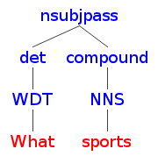
Dependency Tree 1 (DT1)
(Severyn et al., 2013)
Q
What sports stadium has been billed as “the eighth wonder of the world"?
det(stadium, What)
nsubjpass(billed,stadium)
compound(stadium, sport)

Slide 112
Dependency Tree 1 (DT1)
(Severyn et al., 2013)
Q
What sports stadium has been billed as “the eighth wonder of the world"?
det(stadium, What)
compound(stadium, sport)
nsubjpass(billed,stadium)

Slide 113
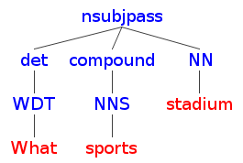
Dependency Tree 1 (DT1)
(Severyn et al., 2013)
Q
What sports stadium has been billed as “the eighth wonder of the world"?
det(stadium, What)
compound(stadium, sport)
nsubjpass(billed,stadium)

Slide 114
Dependency Tree 1 (DT1)
(Severyn et al., 2013)
Q
What sports stadium has been billed as “the eighth wonder of the world"?
det(stadium, What)
compound(stadium, sport)
nsubjpass(billed,stadium)
root(ROOT, billed)

Slide 115
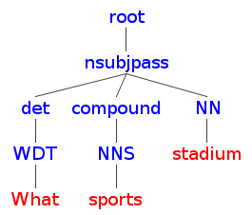
Dependency Tree 1 (DT1)
(Severyn et al., 2013)
Q
What sports stadium has been billed as “the eighth wonder of the world"?
det(stadium, What)
compound(stadium, sport)
nsubjpass(billed,stadium)
root(ROOT, billed)

Slide 116
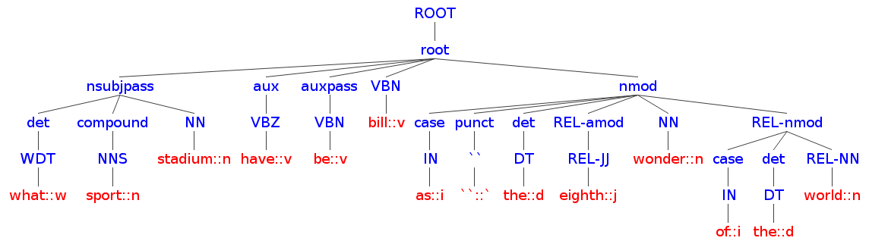
Dependency Tree 1 (DT1)
(Severyn et al., 2013)
Q
What sports stadium has been billed as “the eighth wonder of the world"?

Slide 117
Dependency Tree 1 (DT1)
(Severyn et al., 2013)
Q
What sports stadium has been billed as “the eighth wonder of the world"?
The structure is deep and may result in a too sparse feature space

Slide 118
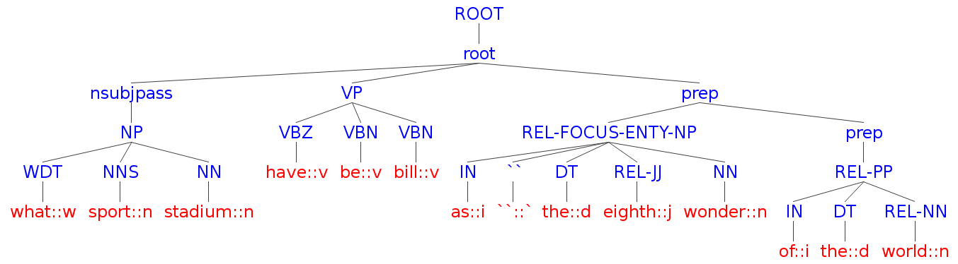
Dependency Tree 2 (DT2)
(Severyn, 2015)
(Tymoshenko and Moschitti, 2015)
Q
What sports stadium has been billed as “the eighth wonder of the world"?
Flatten DT1 -> do not use dependency relations within a chunk

Slide 119
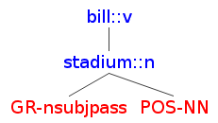
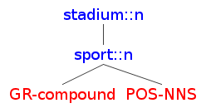
Dependency Tree 3 (DT3)
(Croce et al., 2011)
Q
What sports stadium has been billed as “the eighth wonder of the world"?
nsubjpass(billed,stadium)
compound(stadium, sport)

Slide 120
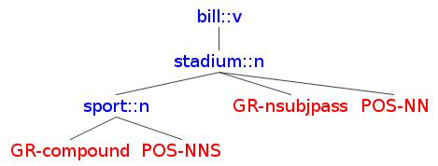
Dependency Tree 3 (DT3)
inspired by (Croce et al., 2011)
Q
What sports stadium has been billed as “the eighth wonder of the world"?
nsubjpass(billed,stadium)
compound(stadium, sport)

Slide 121
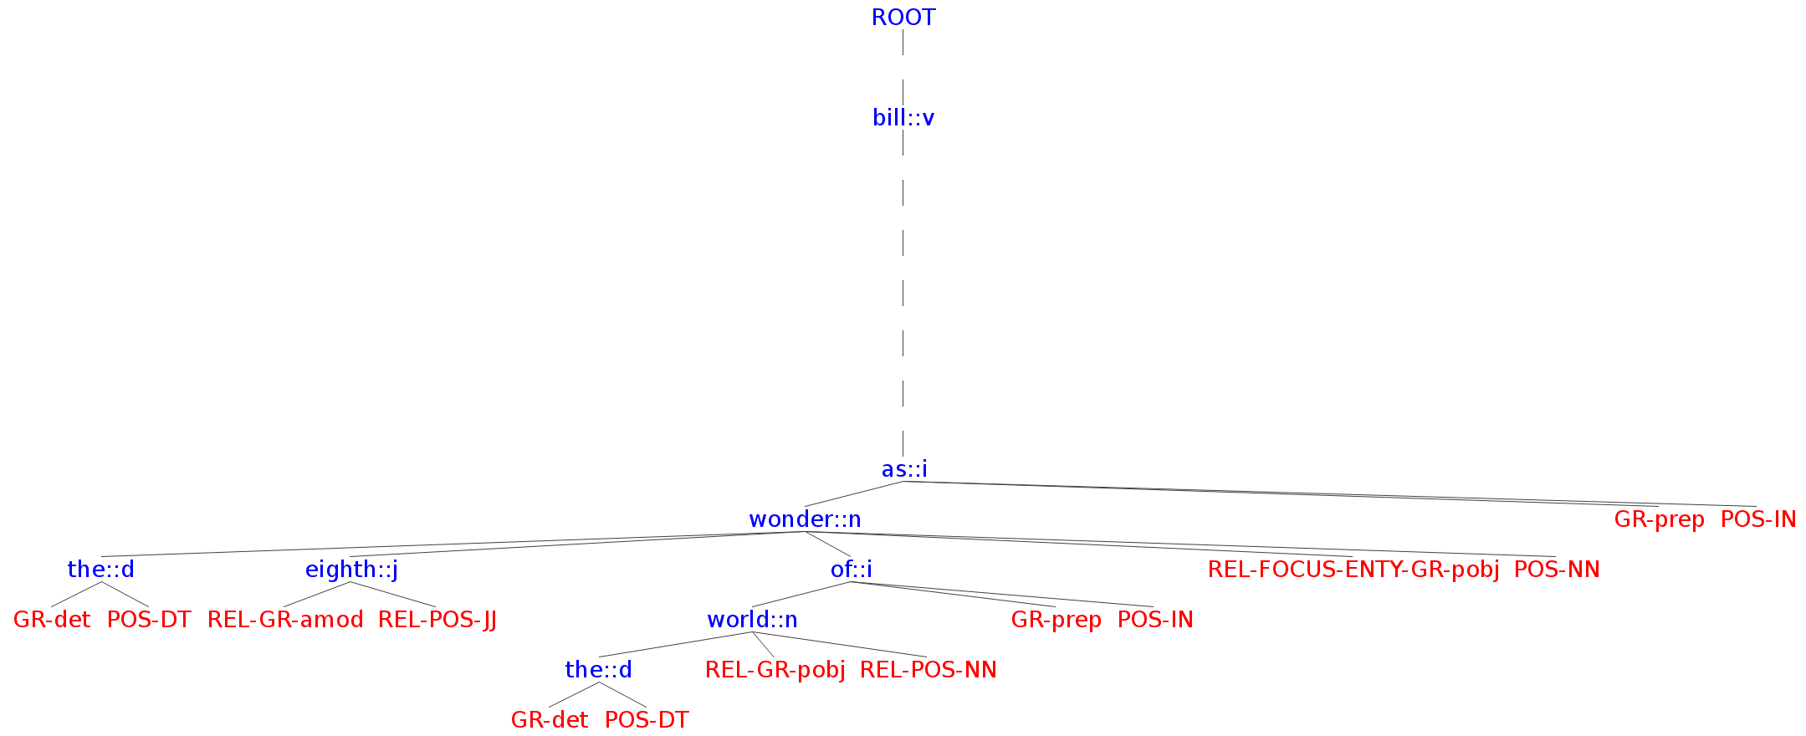
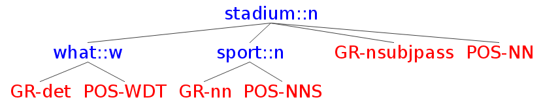

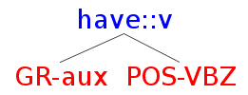
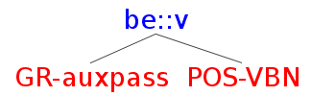
Dependency Tree 3 (DT3)
(Croce et al., 2011)
Q
What sports stadium has been billed as “the eighth wonder of the world"?

Slide 122

DT3+REL
(Croce et al., 2011)
(Tymoshenko and Moschitti, 2015)
Q
What sports stadium has been billed as “the eighth wonder of the world"?

Slide 123
Outline
IR-based QA and its components
Motivation behind the approach
Learning with kernels
Tree kernels recap
Structural representations and relational links for Answer Sentence Selection (IR-based QA)
Structural representations for Community Question Answering
Metrics and results

Slide 124
Shallow structures of cQA
Subject: Psychiatrist in DOHA
Could someone advise the best psychiatrist/psycologist in DOHA?
princess_naila
Comment 1
i heard a good doctor in doha clinic...
feba mariyam
Comment 2
ok..shall check that out..thank you :)
princess_naila
Comment 3
Visit Psychiatrist clinic of Hamad Hospital located opposite ””The Center””
Equin0x

Slide 125
Shallow structures of cQA
Subject: Psychiatrist in DOHA
Could someone advise the best psychiatrist/psycologist in DOHA?
princess_naila
Comment 1
i heard a good doctor in doha clinic...
feba mariyam
Comment 2
ok..shall check that out..thank you :)
princess_naila
Comment 3
Visit Psychiatrist clinic of Hamad Hospital located opposite ””The Center””
Equin0x

Slide 126
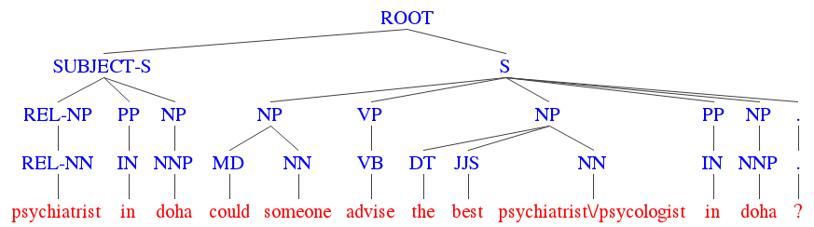
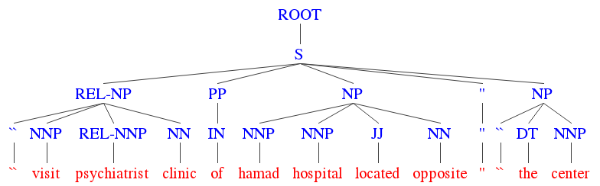
Shallow structures of cQA
Subject: Psychiatrist in DOHA
Could someone advise the best psychiatrist/psycologist in DOHA?
princess_naila
Comment 1
i heard a good doctor in doha clinic...
feba mariyam
Comment 2
ok..shall check that out..thank you :)
princess_naila
Comment 3
Visit Psychiatrist clinic of Hamad Hospital located opposite ””The Center””
Equin0x

Slide 127
Shallow structures of cQA
Subject: Psychiatrist in DOHA
Could someone advise the best psychiatrist/psycologist in DOHA?
princess_naila
Comment 1
i heard a good doctor in doha clinic...
feba mariyam
Comment 2
ok..shall check that out..thank you :)
princess_naila
Comment 3
Visit Psychiatrist clinic of Hamad Hospital located opposite ””The Center””
Equin0x

Slide 128
Shallow structures of cQA
Subject: Psychiatrist in DOHA
Could someone advise the best psychiatrist/psycologist in DOHA?
princess_naila
No question classification
and
focus detection
Comment 1
i heard a good doctor in doha clinic...
feba mariyam
Comment 2
ok..shall check that out..thank you :)
princess_naila
Comment 3
Visit Psychiatrist clinic of Hamad Hospital located opposite ””The Center””
Equin0x

Slide 129
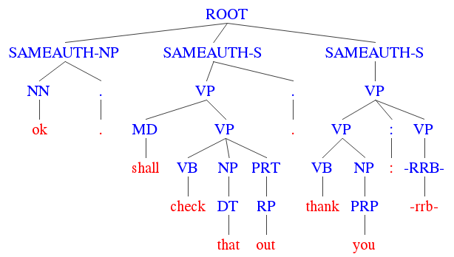
Constituency structures for cQA
Subject: Psychiatrist in DOHA
Could someone advise the best psychiatrist/psycologist in DOHA?
princess_naila
Comment 1
i heard a good doctor in doha clinic...
feba mariyam
Comment 2
ok..shall check that out..thank you :)
princess_naila
Comment 3
Visit Psychiatrist clinic of Hamad Hospital located opposite ””The Center””
129
Equin0x

Slide 130
Constituency structures for cQA
Subject: Psychiatrist in DOHA
Could someone advise the best psychiatrist/psycologist in DOHA?
princess_naila
Same
Author
Comment 1
i heard a good doctor in doha clinic...
feba mariyam
Comment 2
ok..shall check that out..thank you :)
princess_naila
Comment 3
Visit Psychiatrist clinic of Hamad Hospital located opposite ””The Center””
130
Equin0x

Slide 131
Constituency structures for cQA
Subject: Psychiatrist in DOHA
Could someone advise the best psychiatrist/psycologist in DOHA?
princess_naila
Same
Author
Comment 1
i heard a good doctor in doha clinic...
feba mariyam
Comment 2
ok..shall check that out..thank you :)
princess_naila
Comment 3
Visit Psychiatrist clinic of Hamad Hospital located opposite ””The Center””
131
Equin0x

Slide 132
Outline
IR-based QA and its components
Motivation behind the approach
Learning with kernels
Tree kernels recap
Structural representations and relational links for Answer Sentence Selection (IR-based QA)
Structural representations for Community Question Answering
Metrics and results

Slide 133
Evaluation metrics: Precision at rank K (P@K)
Precision of the system in the first K positions
P@1 is 0.33 in the example below
Q1
Correct
2. Wrong
3. Wrong
4. Correct
5. Wrong
Q2
Wrong
2. Wrong
3. Wrong
4. Correct
5. Wrong
Q3
Wrong
2. Correct
3. Correct
4. Correct
5. Wrong

Slide 134
Evaluation metrics: Mean reciprocal rank (MRR)
- amount of questions in the corpus
- rank of the correct answer for the i-th question
Q1
Correct
2. Wrong
3. Wrong
4. Correct
5. Wrong
Q2
Wrong
2. Wrong
3. Wrong
4. Correct
5. Wrong
Q3
Wrong
2. Correct
3. Correct
4. Correct
5. Wrong
Rank1 = 1
Rank3 = 2
Rank2 = 4
MRR = (1 + 0.25 + 0.5)/3 = 0.5833

Slide 135
Evaluation metrics: mean average precision (MAP)
- 1 if item at rank K is relevant, 0 otherwise
- precision at rank K
Q1
Correct
2. Wrong
3. Wrong
4. Correct
5. Wrong
Q2
Wrong
2. Wrong
3. Wrong
4. Correct
5. Wrong
Q3
Wrong
2. Correct
3. Correct
4. Correct
5. Wrong
AveP(Q1) = (1*1 + 0.5*0 + 1/3*0 +1/2*1 +1/5*0)/2=0.75
MAP = (0.75+0.25+0.6388)/3 = 0.5462
AveP(Q2) = (0.25*1)/1=0.25
AveP(Q3) = (0.5*1+2/3*1+0.75*1)/3=0.6388

Slide 136
Answer Sentence Selection datasets
 | TRAIN | TEST | TEST annotation
TREC QA 2002/2003 | 824 | 5-fold cross-validation | Automatic patterns
TREC 13 | 1229 | 68 | Manual
WikiQA | 873 | 243 | Crowdsourcing

Slide 137
Structures comparison on Trec QA 2002/2003: experimental settings
(Tymoshenko&Moschitti, 2015)
Pipelines: Stanford, OpenNLP (POS-tagging, NER)
Dependency parsers: MATE, Stanford, ClearNLP, Malt
External LOD knowledge sources for TM match:
YAGO2, Dbpedia 3.9, WordNet 3.0
Wikification: Machine Linking (not available anymore), Wikipedia Miner (TODO: cite)
SVM-Light-TK for kernel-based learning

Slide 138
Structures comparison on Trec QA 2002/2003: experimental settings
10 candidate answers for training, 50 for testing
Preference reranking with kernels (Severyn et al, 2013)
Partial Tree Kernel for structures (Moschitti, 2006)
Polynomial kernel for vectors

Slide 139
Structures comparison on Trec QA 2002/2003: models
IR baseline
Terrier engine, BM25 model
Models: structures+ feature vectors
V: feature vector
Cosine between answer (A) and passage (P)
Partial Tree Kernel (PTK) applied to Q and P
IR BM25 score

Slide 140
Trec QA: Structure comparison
TREC QA 2002/2003
Stanford pipeline
Dependency
based
Shallow
Simple features
IR baseline

Slide 141
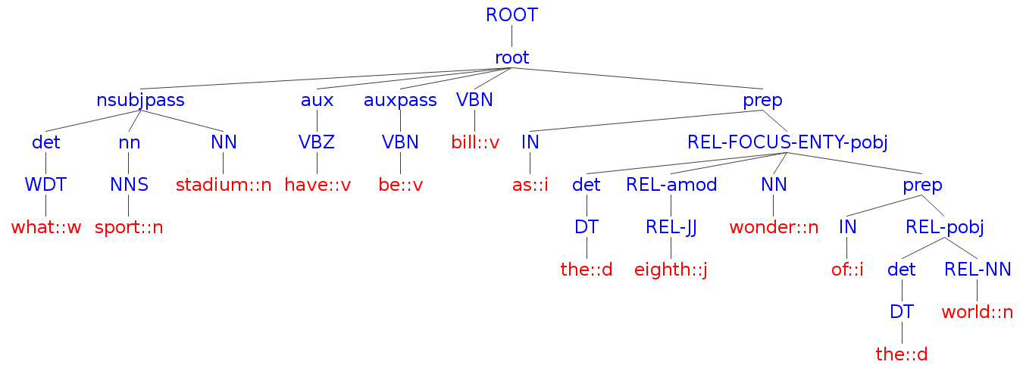
Recap: shallow and dependency-based structures
Shallow: CH+FREL
Dependency-based: DT1

Slide 142
Recap: shallow and dependency-based structures
Shallow: CH+FREL
Dependency-based: DT2

Slide 143
Recap: shallow and dependency-based structures
Shallow: CH+FREL
Dependency-based: DT3

Slide 144
Trec QA: Structure comparison
TREC QA 2002/2003
Stanford pipeline
Dependency
based
Shallow
Simple features
IR baseline

Slide 145
Structure comparison (MRR, MAP, P@1)
Dependency
based
TREC QA 2002/2003
Stanford pipeline
Shallow
Simple features
IR baseline
Notes:
89.26 50

Slide 146
Dependency parser comparison
TREC QA 2002/2003
DT3Q+DT2A +V+FREL structure

Slide 147
LOD Contribution
TREC QA 2002/2003
OpenNLP pipeline
CH structure
Y: YAGO
W: WordNet
D: DBpedia
44.99
CH+V+FREL+VL

Slide 148
Encoding type match: TM
Q
What sports stadium has been billed as “the eighth wonder of the world"?
TM
TM
A
The Titans played in the dilapidated Astrodome; if this was the eighth wonder of the world, we live on a shabby little planet indeed.

Slide 149
LOD Contribution
TREC QA 2002/2003
OpenNLP pipeline
CH structure
Y: YAGO
W: WordNet
D: DBpedia
44.99
LOD matches as vector features
CH+V+FREL+VL

Slide 150
LOD Contribution
TREC QA 2002/2003
OpenNLP pipeline
CH structure
Y: YAGO
W: WordNet
D: DBpedia
44.99
CH+V+FREL+VL

Slide 151
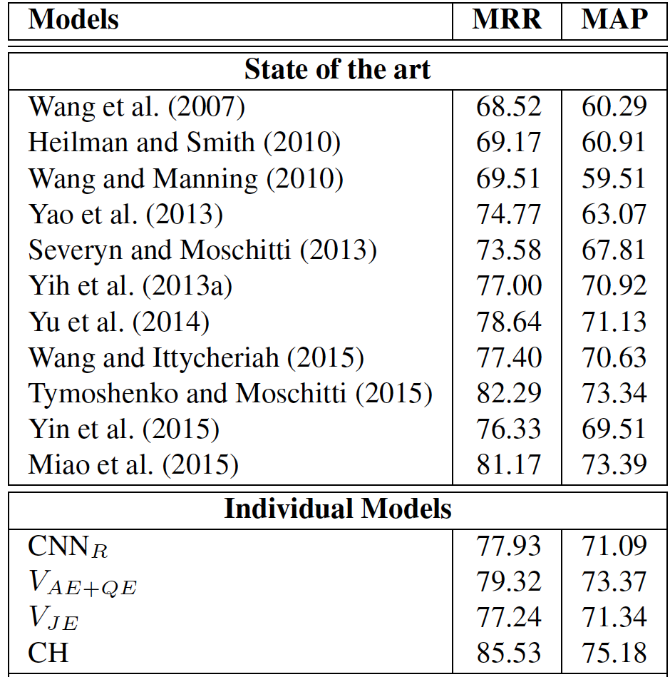
Pipeline performance on TREC13
(Tymoshenko et al., 2016a)
Related work
inlcluding
deep learning
models
CNN (similar to the one you trained on WikiQA)
Q/Answer embeddings
learned by CNN
SVM TK on shallow structure

Slide 152
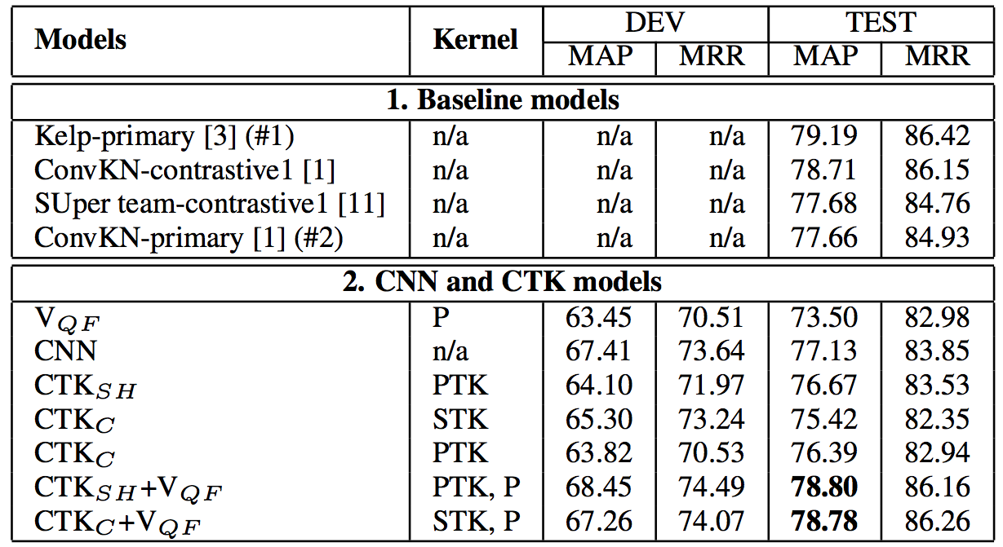
Pipeline performance in SemEval, Task 3.A competition
(Tymoshenko et al., 2016b)
Challenge
winners

Slide 153
Pipeline performance in SemEval, Task 3.A competition
(Tymoshenko et al., 2016b)
Challenge
winners
Same system

Slide 154
Pipeline performance in SemEval, Task 3.A competition
(Tymoshenko et al., 2016b)
Challenge
winners
Domain feature vector
Neural Network
Shallow struct
Constituency struct
Structure +
Feature vector

Slide 155
Outline
High-level QA domain overview
Ikernels Advanced Answer Passage reranking pipeline
(Lab) RelTextRank in action
Go to https://github.com/iKernels/RelTextRank for the instructions
Notes:
ls /Library/Java/JavaVirtualMachines/jdk1.8.0_40.jdk/Contents/Home

Slide 156
References
(Li&Roth, 2002) Li, Xin, and Dan Roth. "Learning question classifiers." Proceedings of the 19th international conference on Computational linguistics-Volume 1. Association for Computational Linguistics, 2002.
(Prager, 2006) Prager, John M. "Open-Domain Question-Answering." Foundations and trends in information retrieval 1.2 (2006): 91-231
(Bunescu and Huang, 2010) Bunescu, Razvan, and Yunfeng Huang. "Towards a general model of answer typing: Question focus identification." Proceedings of The 11th International Conference on Intelligent Text Processing and Computational Linguistics (CICLing 2010), RCS Volume. 2010.
(Quarteroni et al., 2012) Silvia Quarteroni, Vincenzo Guerrisi, and Pietro La Torre. 2012. Evaluating multi-focus natural lan guage queries over data services. In LREC.
(Damljanovic et al., 2010) Danica Damljanovic, Milan Agatonovic, and Hamish Cunningham. 2010. Identification of the question focus: Combining syntactic analysis and ontology- based lookup through the user interaction. In LREC.
(Moschitti, 2006) Efficient convolution kernels for dependency and constituent syntactic trees. In ECML.

Slide 157
References
(Severyn & Moschitti, SIGIR2012) Severyn, Aliaksei, and Alessandro Moschitti. "Structural relationships for large-scale learning of answer re-ranking." Proceedings of the 35th international ACM SIGIR conference on Research and development in information retrieval. ACM, 2012.
(Severyn et al., 2013) Severyn, Aliaksei, Massimo Nicosia, and Alessandro Moschitti. "Learning Adaptable Patterns for Passage Reranking." CoNLL. 2013.
(Severyn, 2015) Modelling input texts: from Tree Kernels to Deep Learning, PhD thesis, UNITN, April 2015
(Tymoshenko and Moschitti, 2015) Tymoshenko, Kateryna, and Alessandro Moschitti. "Assessing the Impact of Syntactic and Semantic Structures for Answer Passages Reranking." Proceedings of the 24th ACM International on Conference on Information and Knowledge Management. ACM, 2015.
(Croce et al., 2011) Croce, Danilo, Alessandro Moschitti, and Roberto Basili. "Structured lexical similarity via convolution kernels on dependency trees." Proceedings of the Conference on Empirical Methods in Natural Language Processing. Association for Computational Linguistics, 2011.
(Tymoshenko and Moschitti, 2014) Tymoshenko, Kateryna, Alessandro Moschitti, and Aliaksei Severyn. "Encoding Semantic Resources in Syntactic Structures for Passage Reranking." EACL. 2014.

Slide 158
References
(Wang, 2007) Wang, Mengqiu, Noah A. Smith, and Teruko Mitamura. "What is the Jeopardy Model? A Quasi-Synchronous Grammar for QA." EMNLP-CoNLL. Vol. 7. 2007.
(Heilman & Smith, 2010) Heilman, Michael, and Noah A. Smith. "Tree edit models for recognizing textual entailments, paraphrases, and answers to questions." Human Language Technologies: The 2010 Annual Conference of the North American Chapter of the Association for Computational Linguistics. Association for Computational Linguistics, 2010.
(Wang & Manning, 2010) Wang, Mengqiu, and Christopher D. Manning. "Probabilistic tree-edit models with structured latent variables for textual entailment and question answering." Proceedings of the 23rd International Conference on Computational Linguistics. Association for Computational Linguistics, 2010.
(Yao et al., 2013) Yao, Xuchen, et al. "Answer Extraction as Sequence Tagging with Tree Edit Distance." HLT-NAACL. 2013.
(Severyn & Moschitti, 2015) Severyn, Aliaksei, and Alessandro Moschitti. "Learning to rank short text pairs with convolutional deep neural networks." Proceedings of the 38th International ACM SIGIR Conference on Research and Development in Information Retrieval. ACM, 2015.
(Wang and Nyberg, 2015) Wang, Di, and Eric Nyberg. "A long short-term memory model for answer sentence selection in question answering." ACL, July (2015).

Slide 159
References
(Bordes et al. 2014) Bordes, Antoine, Sumit Chopra, and Jason Weston. "Question Answering with Subgraph Embeddings." EMNLP 2014.
(Tymoshenko et al, 2016a) Tymoshenko, Kateryna, Daniele Bonadiman, and Alessandro Moschitti. "Convolutional Neural Networks vs. Convolution Kernels: Feature Engineering for Answer Sentence Reranking." Proceedings of NAACL-HLT. 2016.
(Tymoshenko et al, 2016b) Tymoshenko, Kateryna, Daniele Bonadiman, and Alessandro Moschitti. "Learning to Rank Non-Factoid Answers: Comment Selection in Web Forums." Proceedings of the 25th ACM International on Conference on Information and Knowledge Management. ACM, 2016.
(Rajpurkar et al., 2016) Rajpurkar, Pranav, Jian Zhang, Konstantin Lopyrev, and Percy Liang. "SQuAD: 100,000+ Questions for Machine Comprehension of Text." ACL 2016
(Nguyen, Tri, et al., 2016) Nguyen, Tri, Mir Rosenberg, Xia Song, Jianfeng Gao, Saurabh Tiwary, Rangan Majumder, and Li Deng. "MS MARCO: A Human Generated MAchine Reading COmprehension Dataset." NIPS 2016
(Croce et al., 2011) Croce, Danilo, Alessandro Moschitti, and Roberto Basili. "Semantic convolution kernels over dependency trees: smoothed partial tree kernel." Proceedings of the 20th ACM international conference on Information and knowledge management. ACM, 2011.

Slide 160
Thank You!

Slide 161
State of the art in Answer Selection
Quasi-synchronous grammars (Wang, 2007)
Tree Edit Distance (Heilman & Smith, 2010)
Probabilistic model to learn TED transformations on dependency trees (Wang & Manning, 2010)
CRF + TED features (Yao et al., 2013)
SVM + shallow parse tree representation (Severyn & Moschitti, 2012, 2013)
Neural Networks (Severyn & Moschitti, 2015) (Wang and Nyberg, 2015)

Slide 162
LOD Contribution
TREC QA 2002/2003
OpenNLP pipeline
CH structure
Y: YAGO
W: WordNet
D: DBpedia

Slide 163
Structures comparison
Stanford pipeline

Slide 164
LOD Contribution
LOD encoded
into trees
Amount of lod matches as vector features
TREC QA 2002/2003
OpenNLP pipeline
CH structure
LOD encoded
into trees
Y: YAGO
W: WordNet
D: DBpedia

Slide 165
TREC13 benchmark

